Slide 1
Event Based Approaches
Oxford University
Software Engineering Programme
April 2021

Slide 2
Why Asynchronous?

Slide 3
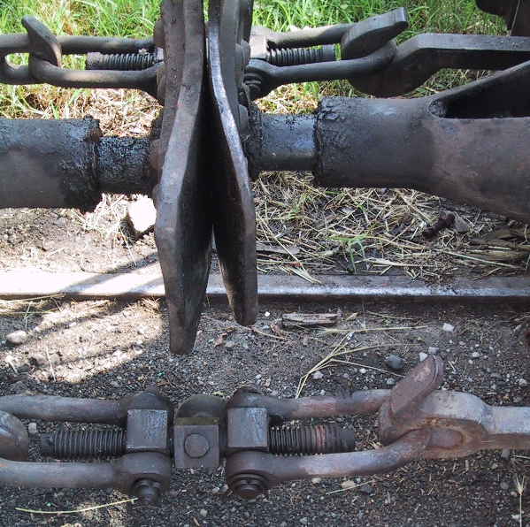
Loose coupling

Slide 4
Event Driven Architecture
Event Consumer
Event Producer
Event
Event Consumer

Slide 5
Loose coupling in EDA
Location
Logical addresses
Time
Asynchronous, Store/Forward, Replay
Message
JSON, XML, ProtoBuf, etc
Pattern
Pub/Sub, Queue, 1-1, 1-many, many-many, request-reply

Slide 6

EDA

Slide 7
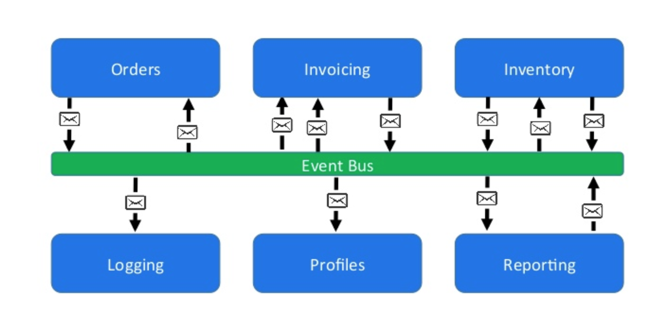
Loose coupling via event bus
https://www.slideshare.net/CentricConsulting/eventdriven-architecture-57613466

Slide 8
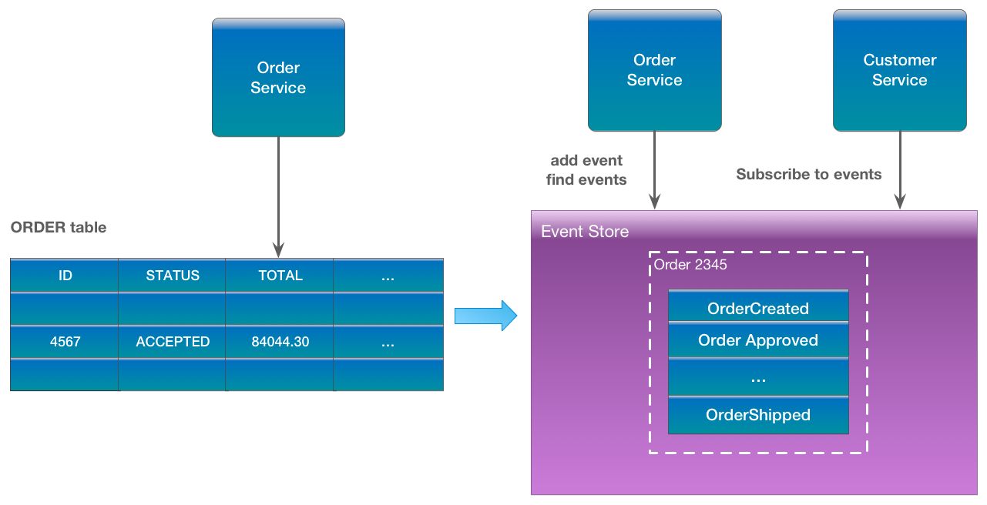
Event Sourcing
https://eventuate.io/whyeventsourcing.html

Slide 9
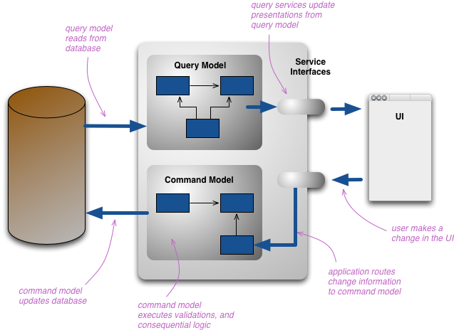
Command Query Responsibility Separation
https://martinfowler.com/bliki/CQRS.html

Slide 10
Message distribution systems
NATS
MQTT
STOMP
AMQP / RabbitMQ
Kafka

Slide 11
NATS
Simple text based protocol
Multiple patterns
Pure Pub/Sub
Request-Reply
Queuing
Clustered servers
Distributed queue across clusters
Cluster aware clients

Slide 12
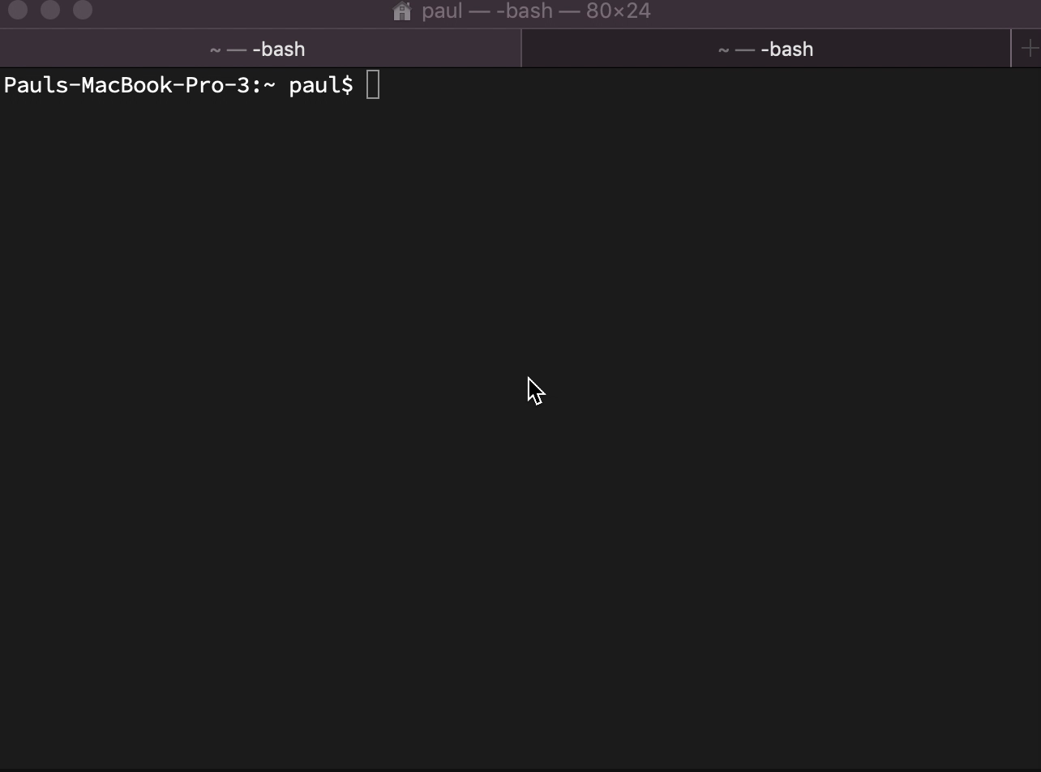
NATS simple demo

Slide 13
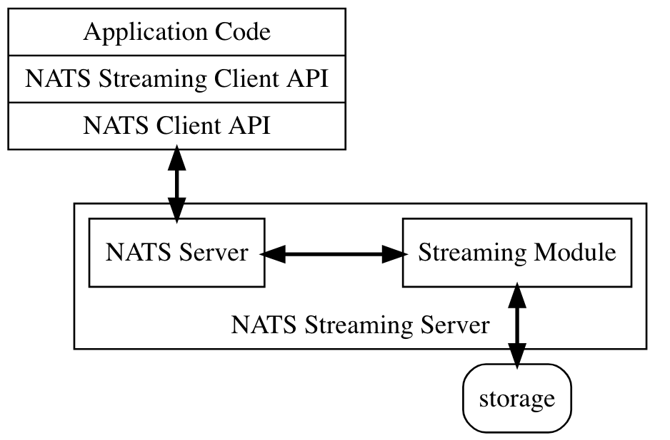
NATS Streaming

Slide 14
NATS Streaming
At least once delivery
Publisher rate limiting
Subscriber rate limiting
Message Replay
Durable Subscriptions

Slide 15
MQTT
Very lightweight binary protocol
2-byte overhead
Widely used in IoT scenarios
Pub-sub only until MQTT5
QoS levels
Fire and forget QoS0
At least once QoS1
Exactly once QoS2

Slide 16
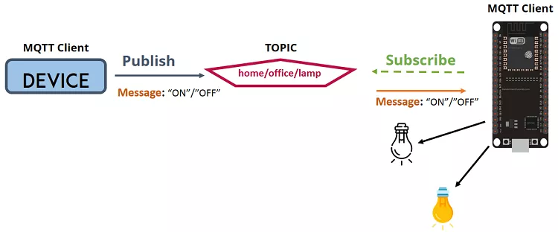
MQTT

Slide 17
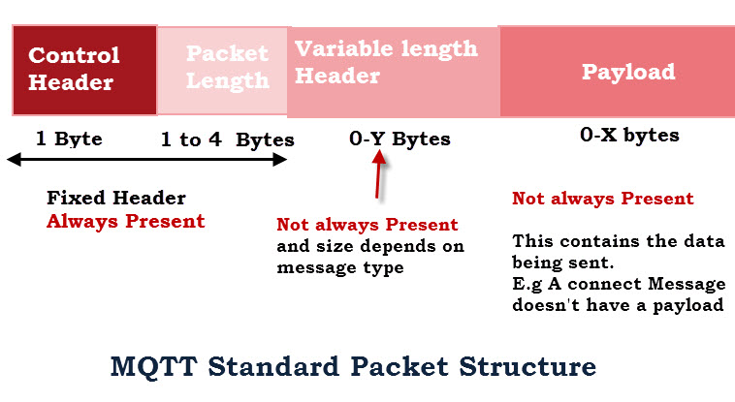
MQTT Packets http://www.steves-internet-guide.com/mqtt-protocol-messages-overview/

Slide 18
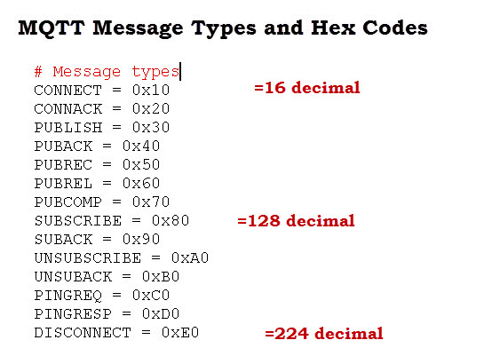

Slide 19
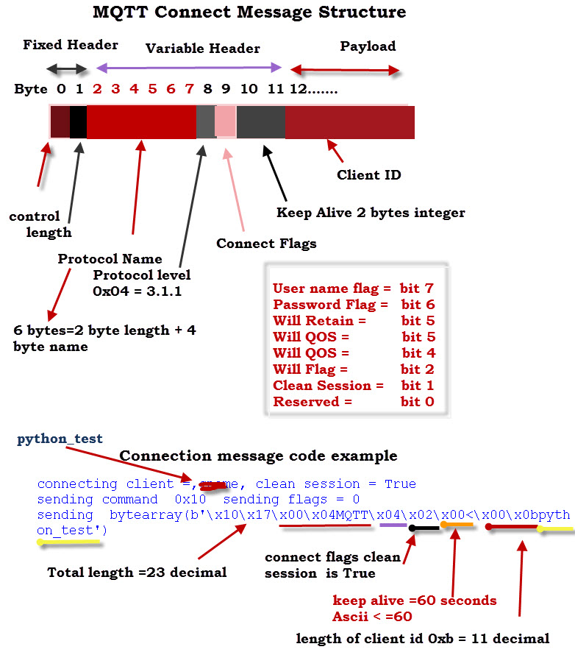

Slide 20
AMQP / RabbitMQ
AMQP is an advanced messaging protocol
Designed to meet more enterprise needs
Emerged from JP Morgan attempting to decouple from proprietary systems
Standardised in OASIS
Although many implementations prefer 0-91 to 1-00

Slide 21
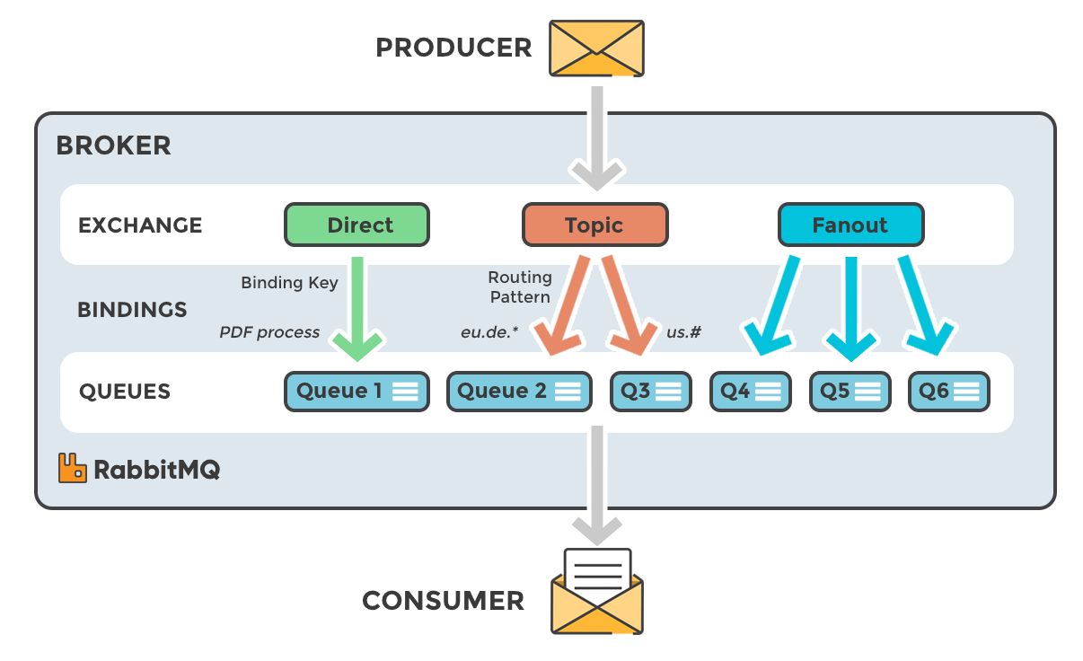

Slide 22
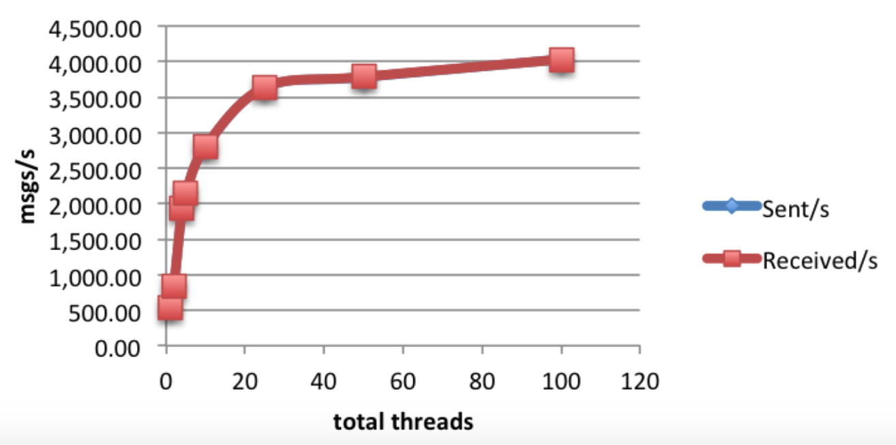
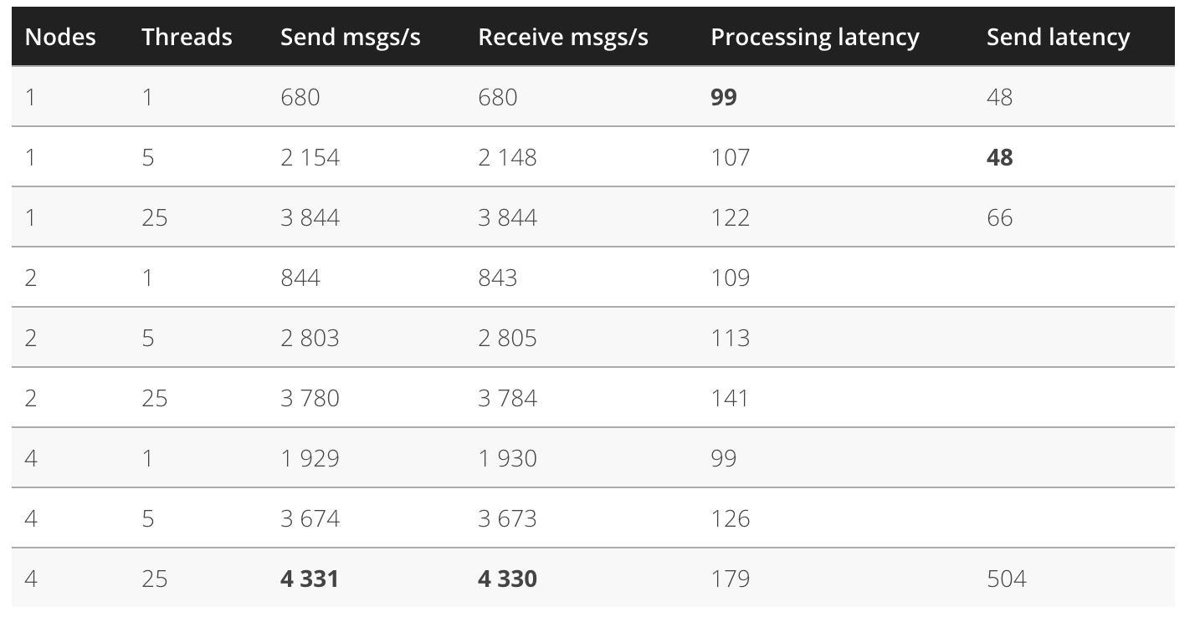
RabbitMQ performance https://softwaremill.com/mqperf/

Slide 23
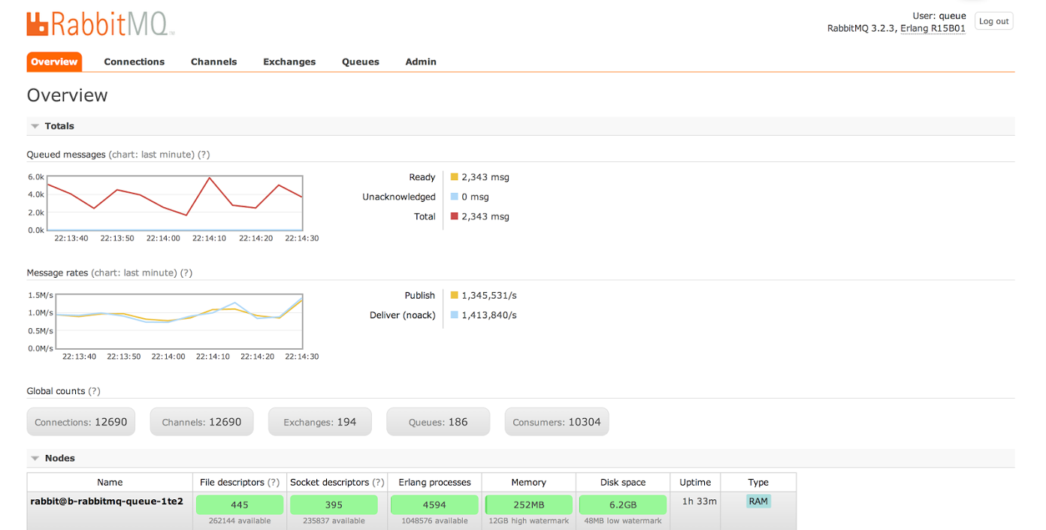
>1m msgs/sec https://content.pivotal.io/blog/rabbitmq-hits-one-million-messages-per-second-on-google-compute-engine

Slide 24
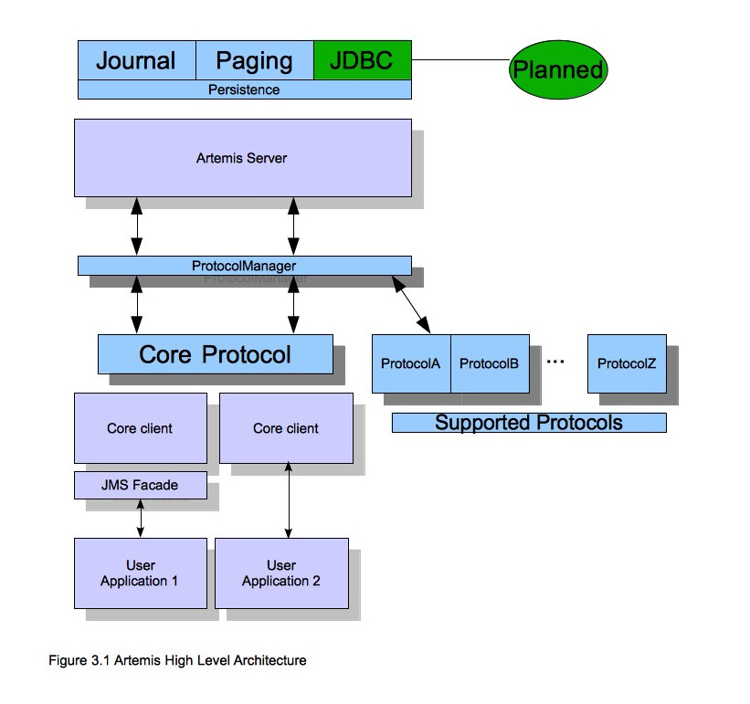
ActiveMQ / Artemis

Slide 25
Artemis
Supports multi-protocols:
“JMS”, AMQP, STOMP, OpenWire, MQTT, REST
Highly available and clusterable
Written in Java

Slide 26
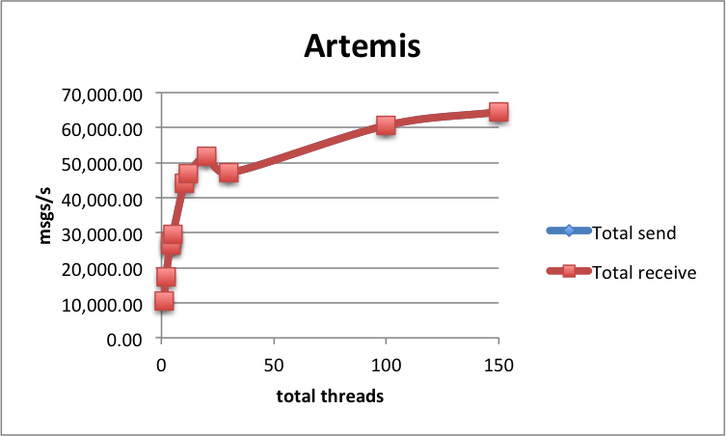
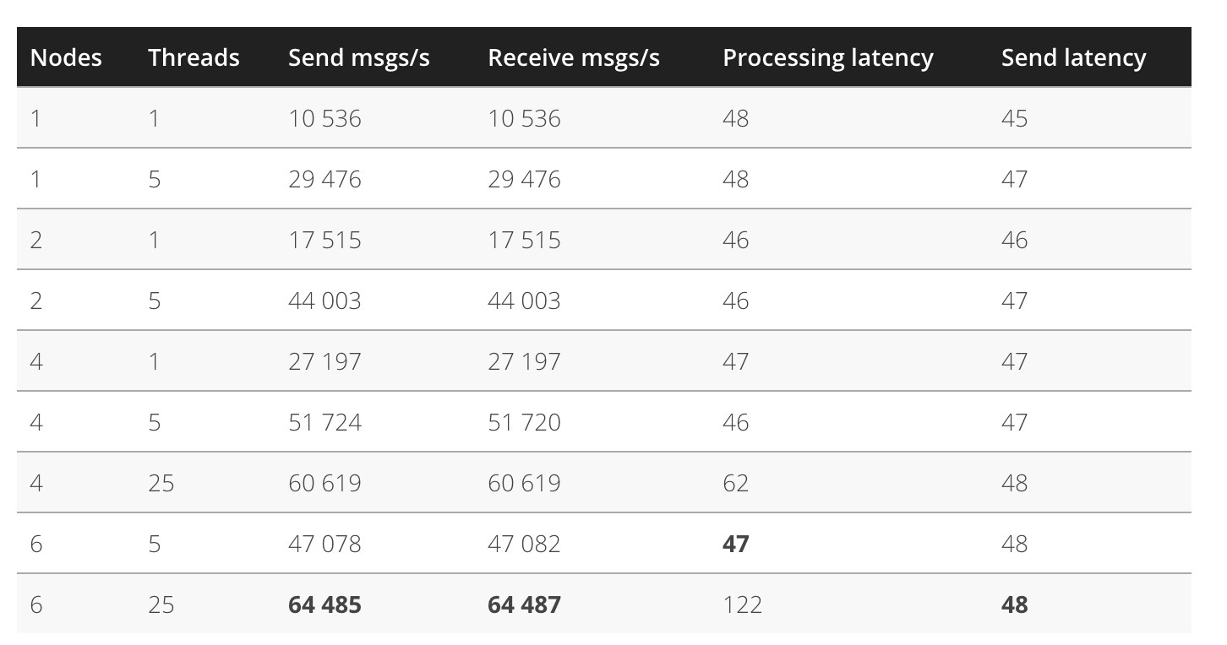
Artemis Performance https://softwaremill.com/mqperf/

Slide 27
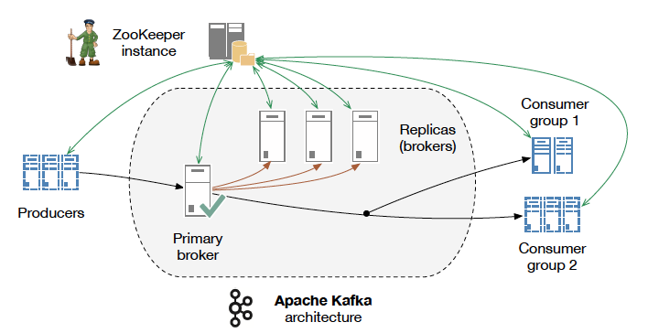
Apache Kafka

Slide 28

Apache Kafka
Source: http://www.slideshare.net/charmalloc/

Slide 29
Kafka
Applying “big data” approaches to messaging:
Partitioning
Multiple brokers
Elastically scalable
Supports clusters of co-ordinated consumers
Automatic re-election of leaders

Slide 30
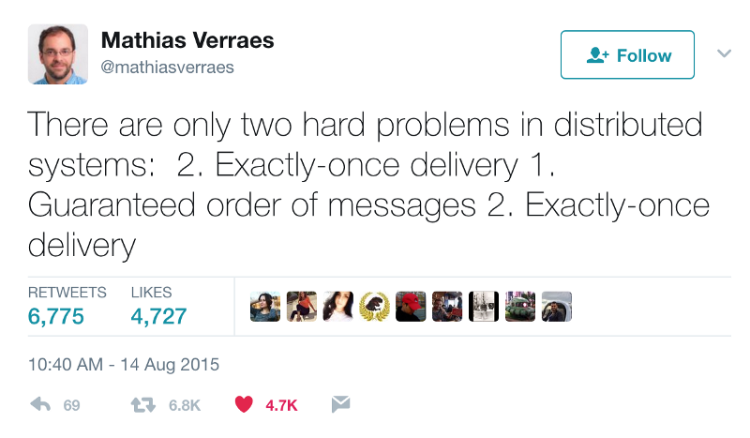
Kafka exactly-once semantics

Slide 31
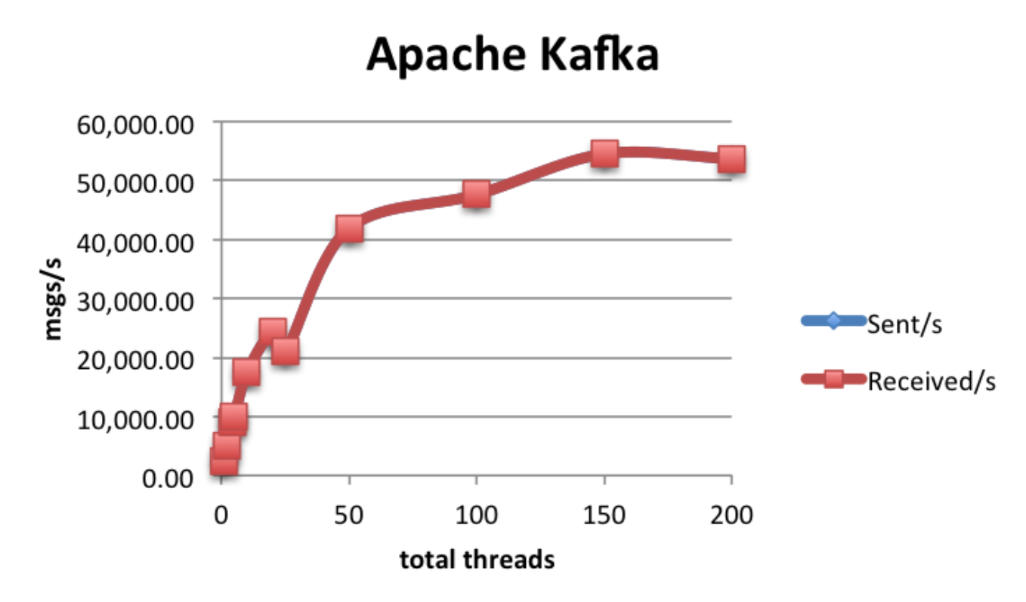
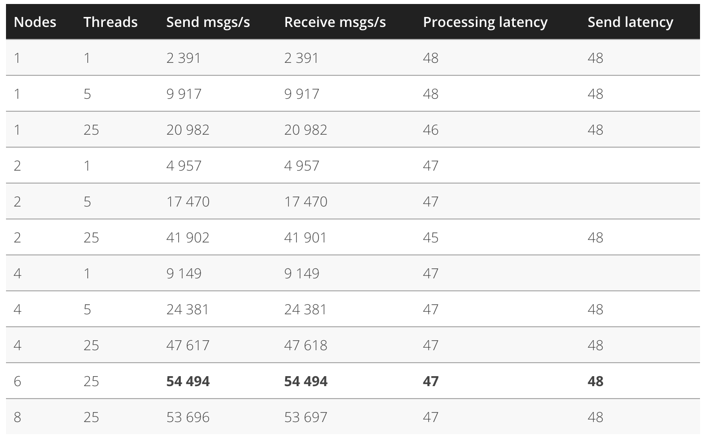
Kafka Performance

Slide 32
Questions?

